Slide 1
ITNW 1335 Cloud Computing
Chapter 6 – Fundamental Cloud Security

Slide 2
6.1. Basic Terms and Concepts
Confidentiality
Integrity
Authenticity
Availability
Threat
Vulneribility
Risk
Security Controls
Security Mechanisms
Security Policies

Slide 3
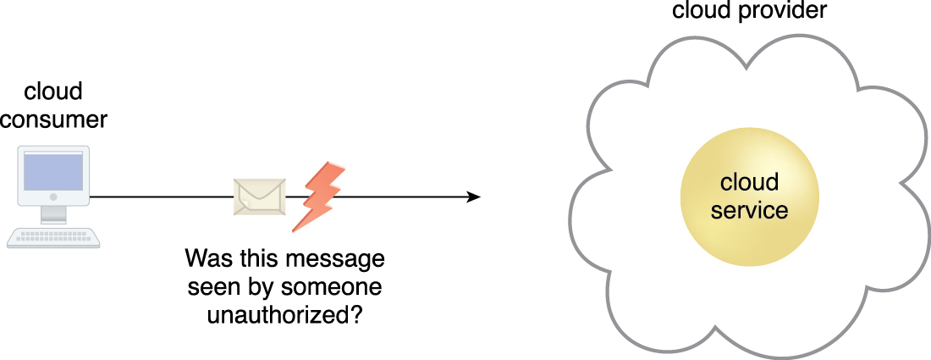
6.1. Basic Terms and Concepts
Confidentiality is the characteristic of something being made accessible only to authorized parties
Within cloud environments, confidentiality primarily pertains to restricting access to data in transit and storage.
Figure 6.1 The message issued by the cloud consumer to the cloud service is considered confidential
only if it is not accessed or read by an unauthorized party.
Notes:
Figure:

Slide 4

6.1. Basic Terms and Concepts
Integrity is the characteristic of not having been altered by an unauthorized party
An important issue that concerns data integrity in the cloud is whether a cloud consumer can be guaranteed that the data it transmits to a cloud service matches the data received by that cloud service
Integrity can extend to how data is stored, processed, and retrieved by cloud services and cloud-based IT resources
Figure 6.2 The message issued by the cloud consumer to the cloud service is considered to have integrity
if it has not been altered.
Notes:
Figure:

Slide 5
6.1. Basic Terms and Concepts
Authenticity
the characteristic of something having been provided by an authorized source
This concept encompasses non-repudiation, which is the inability of a party to deny or challenge the authentication of an interaction
Authentication in non-repudiable interactions provides proof that these interactions are uniquely linked to an authorized source
A user may not be able to access a non-repudiable file after its receipt without also generating a record of this access
Availability
The characteristic of being accessible and usable during a specified time period
The availability of cloud services can be a responsibility that is shared by the cloud provider and the cloud carrier
The availability of a cloud-based solution that extends to cloud service consumers is further shared by the cloud consumer
Threat
A potential security violation that can challenge defenses in an attempt to breach privacy and/or cause harm
Both manually and automatically instigated threats are designed to exploit known weaknesses, also referred to as vulnerabilities. A threat that is carried out results in an attack

Slide 6
6.1. Basic Terms and Concepts
Vulnerability
A weakness that can be exploited either because it is protected by insufficient security controls, or because existing security controls are overcome by an attack
IT resource vulnerabilities can have a range of causes, including configuration deficiencies, security policy weaknesses, user errors, hardware or firmware flaws, software bugs, and poor security architecture
Risk
The possibility of loss or harm arising from performing an activity
Risk is typically measured according to its threat level and the number of possible or known vulnerabilities
Two metrics that can be used to determine risk for an IT resource are
the probability of a threat occurring to exploit vulnerabilities in the IT resource
the expectation of loss upon the IT resource being compromised

Slide 7
6.1. Basic Terms and Concepts
Security Controls
Security controls are countermeasures used to prevent or respond to security threats and to reduce or avoid risk
Details on how to use security countermeasures are typically outlined in the security policy
contains a set of rules and practices specifying how to implement a system, service, or security plan for maximum protection of sensitive and critical IT resources
Security Mechanisms
Countermeasures are typically described in terms of security mechanisms, which are components comprising a defensive framework that protects IT resources, information, and services.
Security Policies
Establishes a set of security rules and regulations
Security policies will further define how these rules and regulations are implemented and enforced

Slide 8
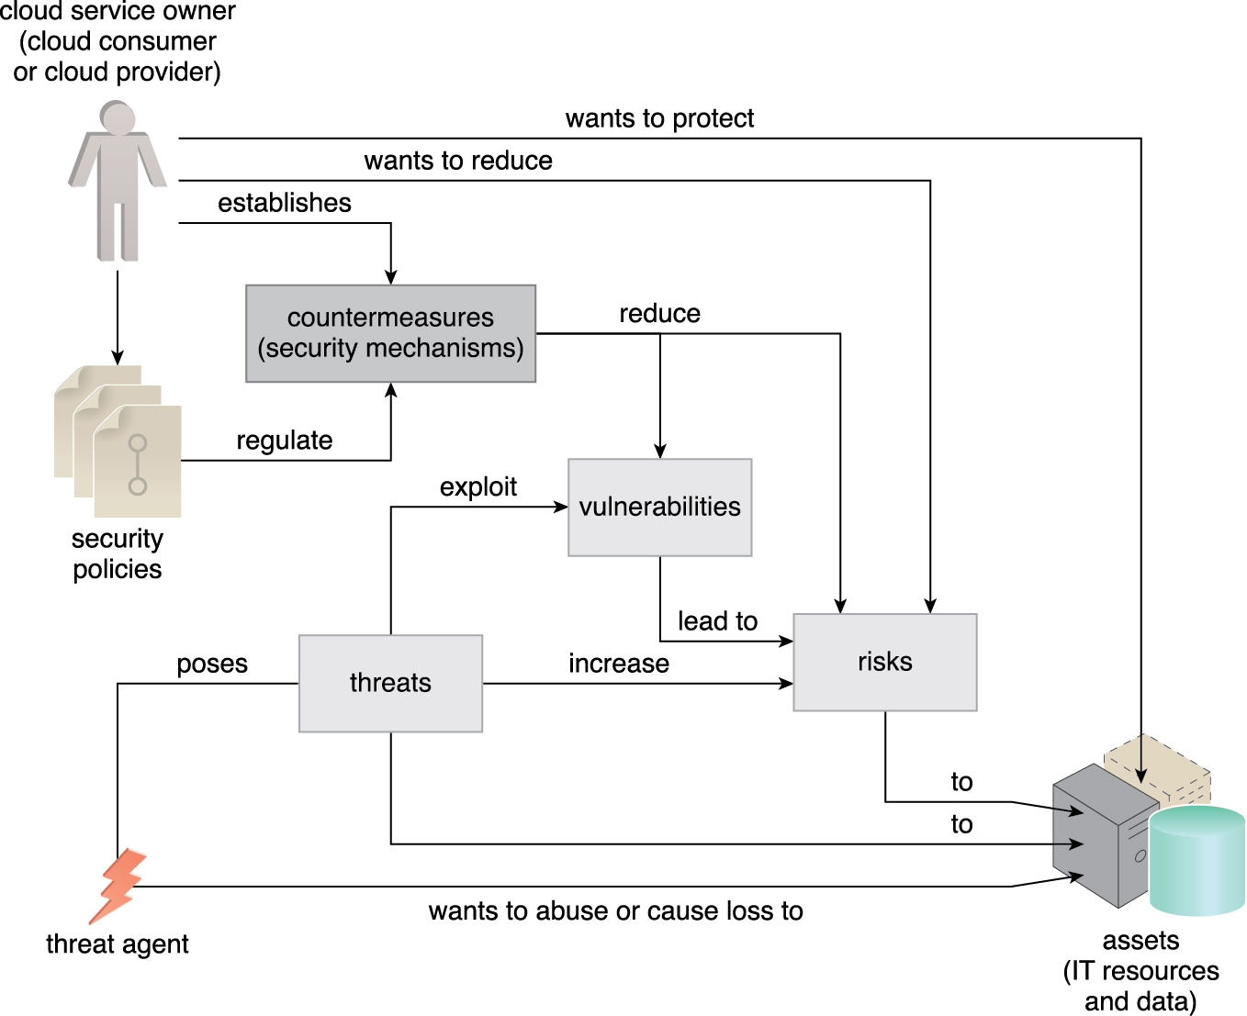
6.2. Threat Agents
A threat agent is an entity that poses a threat because it is capable of carrying out an attack
Cloud security threats can originate either internally or externally, from humans or software programs
Figure 6.3 How security policies and security mechanisms are used to counter threats, vulnerabilities, and risks caused by threat agents.
Notes:
Figure:

Slide 9

6.2. Threat Agents
An anonymous attacker is a non-trusted cloud service consumer without permissions in the cloud
It typically exists as an external software program that launches network-level attacks through public networks
When anonymous attackers have limited information on security policies and defenses, it can inhibit their ability to formulate effective attacks
Therefore, anonymous attackers often resort to committing acts like bypassing user accounts or stealing user credentials, while using methods that either ensure anonymity or require substantial resources for prosecution
Figure 6.4 The notation used for an anonymous attacker.
Notes:
Figure:

Slide 10

6.2. Threat Agents
A malicious service agent is able to intercept and forward the network traffic that flows within a cloud
It typically exists as a service agent (or a program pretending to be a service agent) with compromised or malicious logic
It may also exist as an external program able to remotely intercept and potentially corrupt message contents
Figure 6.5 The notation used for a malicious service agent.
Notes:
Figure:

Slide 11

6.2. Threat Agents
A trusted attacker shares IT resources in the same cloud environment as the cloud consumer and attempts to exploit legitimate credentials to target cloud providers and the cloud tenants with whom they share IT resources
Unlike anonymous attackers (which are non-trusted), trusted attackers usually launch their attacks from within a cloud’s trust boundaries by abusing legitimate credentials or via the appropriation of sensitive and confidential information
Trusted attackers (also known as malicious tenants) can use cloud-based IT resources for a wide range of exploitations, including the hacking of weak authentication processes, the breaking of encryption, the spamming of e-mail accounts, or to launch common attacks, such as denial of service campaigns
Figure 6.6 The notation that is used for a trusted attacker.
Notes:
Figure:

Slide 12
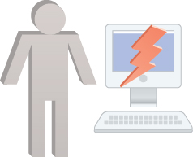
6.2. Threat Agents
Malicious insiders are human threat agents acting on behalf of or in relation to the cloud provider
They are typically current or former employees or third parties with access to the cloud provider’s premises
This type of threat agent carries tremendous damage potential, as the malicious insider may have administrative privileges for accessing cloud consumer IT resources.
Figure 6.7 The notation used for an attack originating from a workstation. The human symbol is optional.
Notes:
Figure:

Slide 13
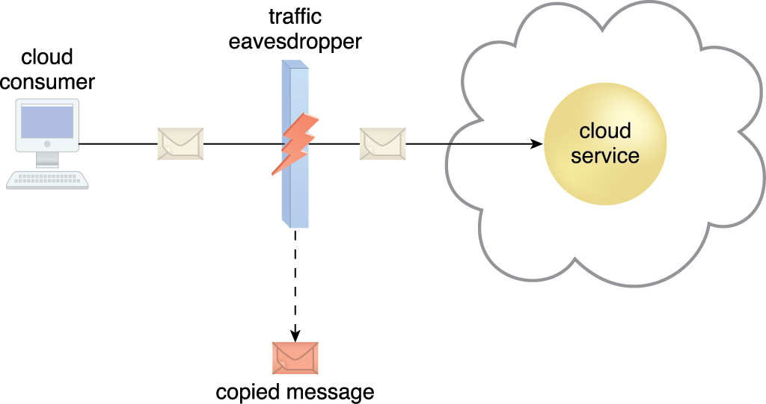
6.3. Cloud Security Threats
Traffic eavesdropping occurs when data being transferred to or within a cloud (usually from the cloud consumer to the cloud provider) is passively intercepted by a malicious service agent for illegitimate information gathering purposes
The aim of this attack is to directly compromise the confidentiality of the data and, possibly, the confidentiality of the relationship between the cloud consumer and cloud provider
Because of the passive nature of the attack, it can more easily go undetected for extended periods of time
Figure 6.8 An externally positioned malicious service agent carries out a traffic eavesdropping attack
by intercepting a message sent by the cloud service consumer to the cloud service. The service
agent makes an unauthorized copy of the message before it is sent along its original path to
the cloud service.
Notes:
Figure:

Slide 14
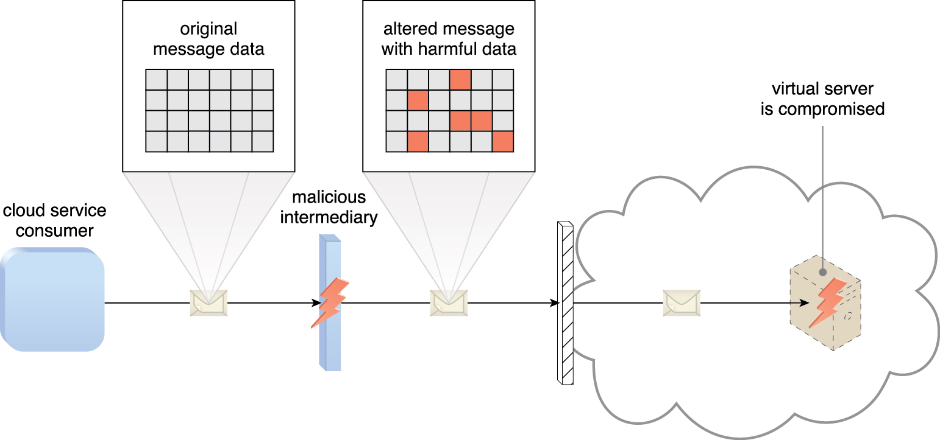
6.3. Cloud Security Threats
The malicious intermediary threat arises when messages are intercepted and altered by a malicious service agent, thereby potentially compromising the message’s confidentiality and/or integrity
It may also insert harmful data into the message before forwarding it to its destination
Figure 6.9 The malicious service agent intercepts and modifies a message sent by a cloud service
consumer to a cloud service (not shown) being hosted on a virtual server. Because
harmful data is packaged into the message, the virtual server is compromised.
Notes:
Figure:

Slide 15
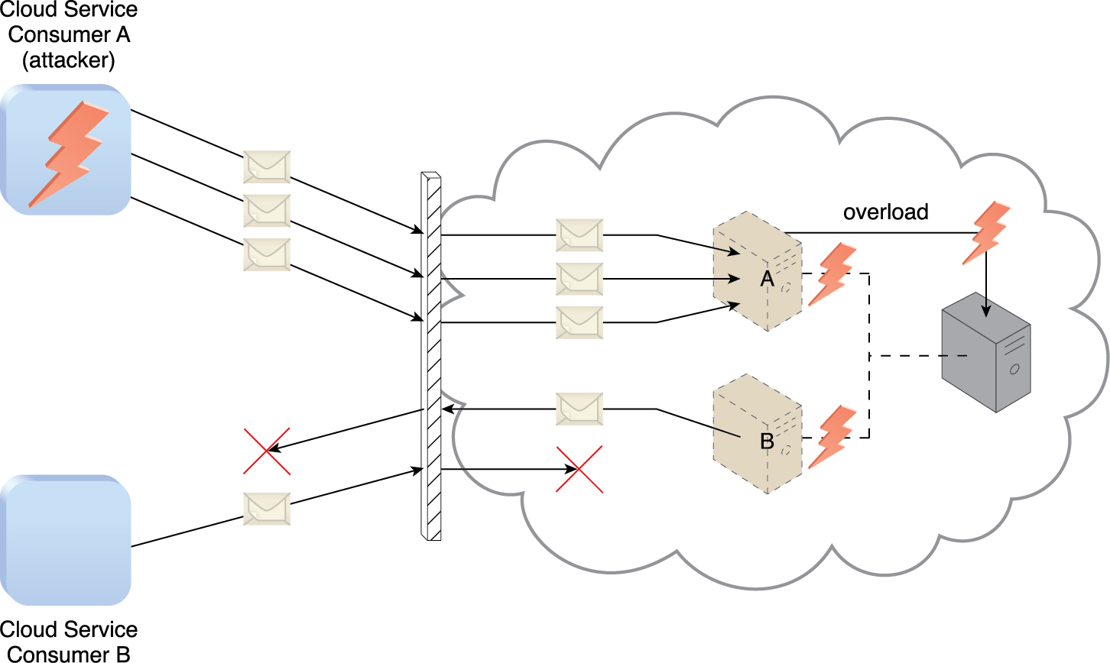
6.3. Cloud Security Threats
Denial of service (DoS) attack objective is to overload IT resources to the point where they cannot function properly by:
The workload on cloud services is artificially increased with imitation messages or repeated communication requests.
The network is overloaded with traffic to reduce its responsiveness and cripple its performance.
Multiple cloud service requests are sent, each of which is designed to consume excessive memory and processing resources
Figure 6.10 Cloud Service Consumer A sends multiple messages to a cloud service (not shown) hosted on Virtual Server A. This overloads the capacity of the underlying physical server, which causes outages with Virtual Servers A and B. As a result, legitimate cloud service consumers, such as Cloud Service Consumer B, become unable to communicate with any cloud services hosted on Virtual Servers A and B.
Notes:
Figure:

Slide 16
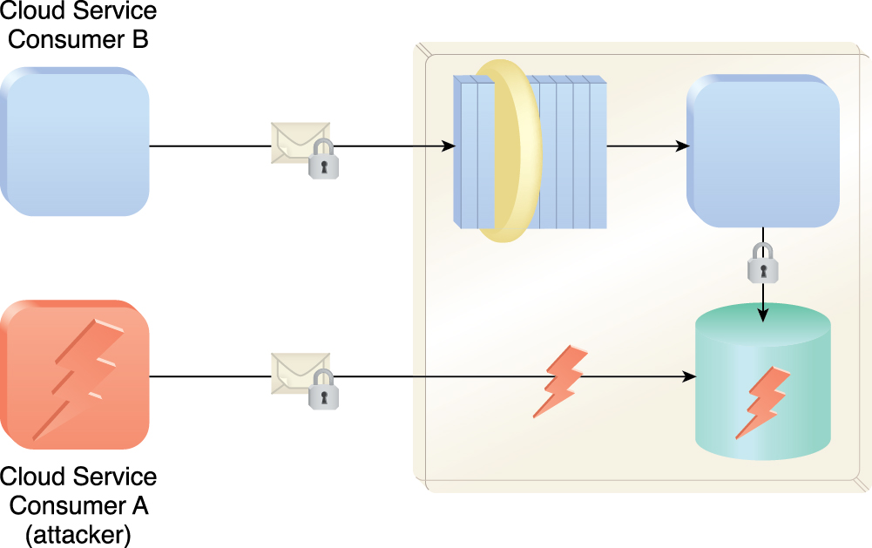
6.3. Cloud Security Threats
Insufficient authorization attack occurs when access is granted to an attacker erroneously or too broadly, resulting in the attacker getting access to IT resources that are normally protected
This is often a result of the attacker gaining direct access to IT resources that were implemented under the assumption that they would only be accessed by trusted consumer programs
Figure 6.11 Cloud Service Consumer A gains access to a database that was implemented under the assumption that it would only be accessed through a Web service with a published service contract (as per Cloud Service Consumer B).
Notes:
Figure:

Slide 17
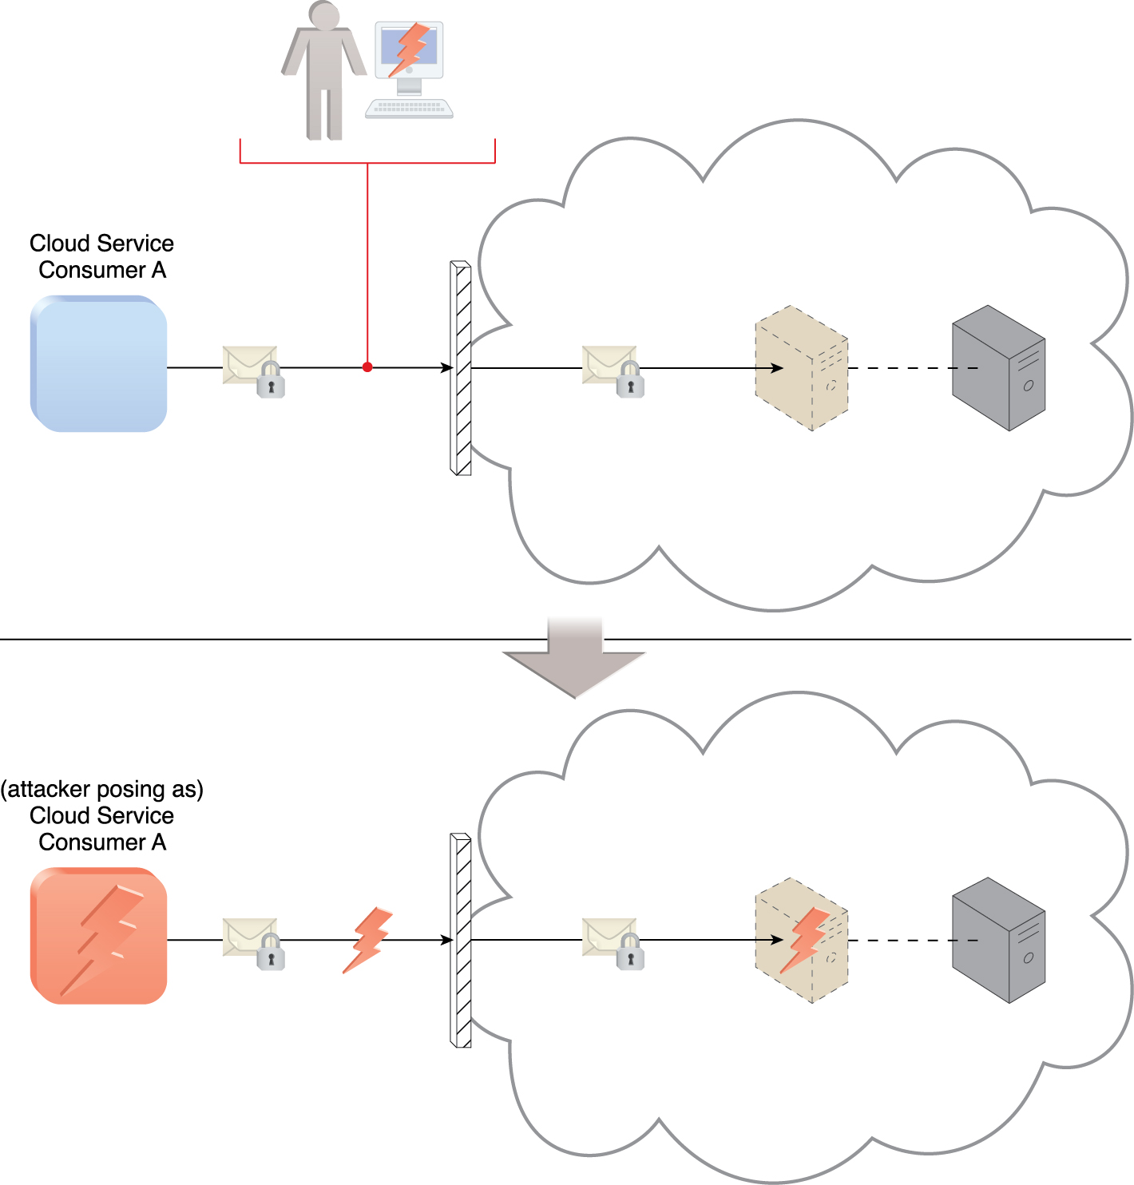
6.3. Cloud Security Threats
Another insufficient authorization, known as weak authentication, can result when weak passwords or shared accounts are used to protect IT resources
Within cloud environments, these types of attacks can lead to significant impacts depending on the range of IT resources and the range of access to those IT resources the attacker gains
Figure 6.12 An attacker has cracked a weak password used by Cloud Service Consumer A. As a result, a malicious cloud service consumer (owned by the attacker) is designed to pose as Cloud Service Consumer A in order to gain access to the cloud-based virtual server.
Notes:
Figure:

Slide 18
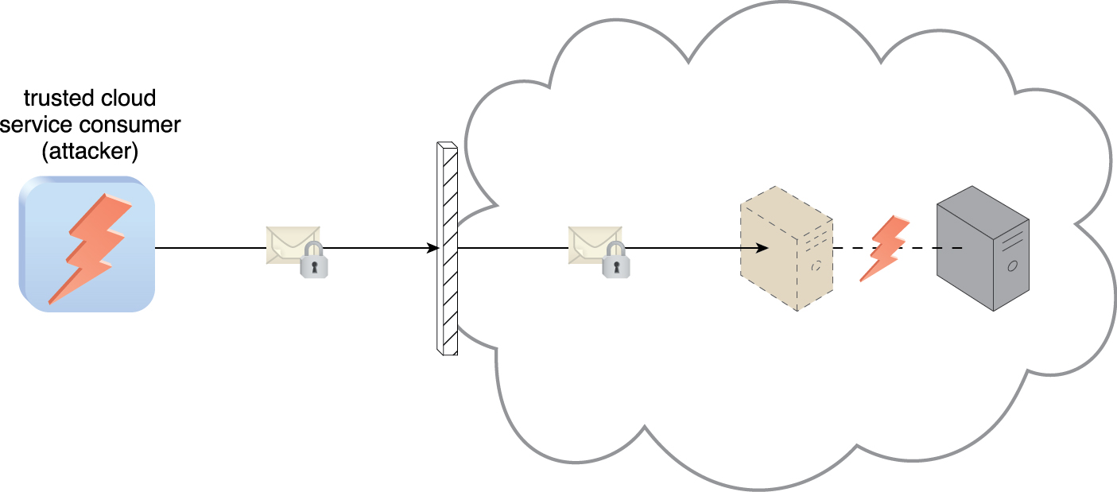
6.3. Cloud Security Threats
A virtualization attack exploits vulnerabilities in the virtualization platform to jeopardize its confidentiality, integrity, and/or availability
This threat is where a trusted attacker successfully accesses a virtual server to compromise its underlying physical server. With public clouds, where a single physical IT resource may be providing virtualized IT resources to multiple cloud consumers, such an attack can have significant repercussions
Figure 6.13 An authorized cloud service consumer carries out a virtualization attack by abusing its administrative access to a virtual server to exploit the underlying hardware.
Notes:
Figure:

Slide 19
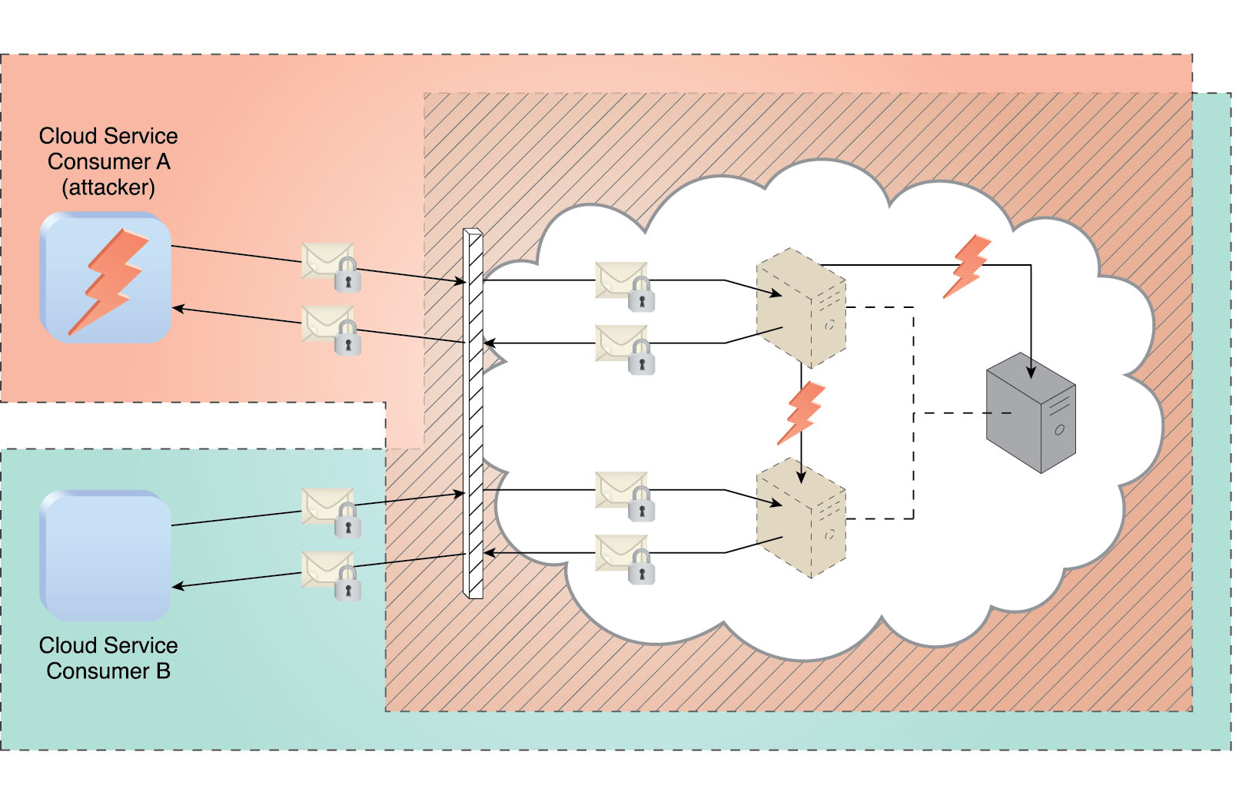
6.3. Cloud Security Threats
Overlapping trust boundaries if physical IT resources within a cloud are shared by different cloud service consumers
Malicious cloud service consumers can target shared IT resources with the intention of compromising cloud consumers or other IT resources that share the same trust boundary
The consequence is that some or all of the other cloud service consumers could be impacted by the attack and/or the attacker could use virtual IT resources against others that happen to also share the same trust boundary
Figure 6.14 Cloud Service Consumer A is trusted by the cloud and therefore gains access to a virtual server, which it then attacks with the intention of attacking the underlying physical server and the virtual server used by Cloud Service Consumer B.
Notes:
Figure:

Slide 20
6.3. Cloud Security Threats - Container Attack
The use of containerization introduces a lack of isolation from the host operating system level
Since containers deployed on the same machine share the same host operating system, security threats can increase because access to the entire system can be gained
If the underlying host is compromised, all containers running on the host may be impacted
Impact is limited if containers are created from within an OS running on a VM
Only that VM is compromised

Slide 21
6.3. Cloud Security Threats - Container Attack
Another option is a one-service per physical server deployment model where all container images deployed on the same host are the same
This can reduce risk without the need to virtualize the IT resources
A security breach to one cloud service instance would only allow access to other instances, and the residual risk could be considered as acceptable
May not be optimal for deploying many different cloud services because it can significantly increase the total number of physical IT resources that need to be deployed and managed while further increasing cost and operational complexity

Slide 22
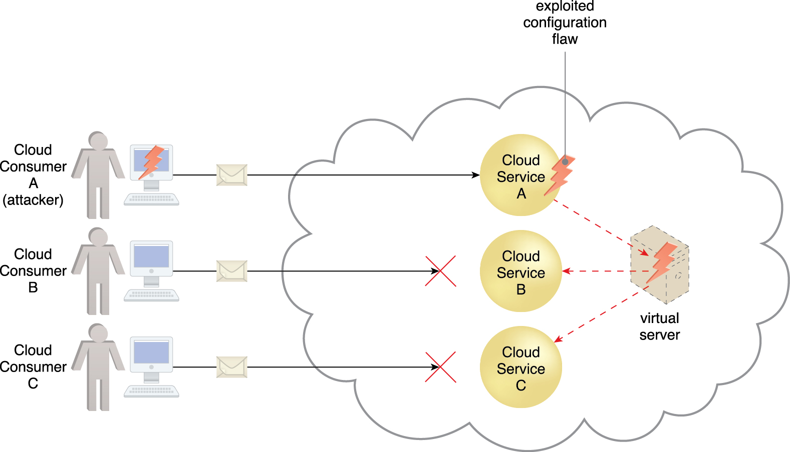
6.4. Additional Considerations
Flawed Implementations is a substandard design, implementation, or configuration of cloud service deployments can have undesirable consequences, beyond runtime exceptions and failures
If the cloud provider’s software and/or hardware have inherent security flaws or operational weaknesses, attackers can exploit these vulnerabilities to impair the integrity, confidentiality, and/or availability of cloud provider IT resources and cloud consumer IT resources hosted by the cloud provider.
Figure 6.15 Cloud Service Consumer A’s message triggers a configuration flaw in Cloud Service A, which in turn causes the virtual server that is also hosting Cloud Services B and C to crash.
Notes:
Figure:

Slide 23
6.4. Additional Considerations
Security Policy Disparity
When a cloud consumer places IT resources with a public cloud provider, it may need to accept that its traditional information security approach may not be identical or even similar to that of the cloud provider
This needs to be assessed to maintain adequate protection
Additional 3rd parties like security brokers and CAs adds more complexities
Contracts
Needs to be understood by consumer when it comes to security policies
The amount of liability should be clear (greater liability by CP, lower risk for CC)
Asset lines need to be drawn between CP and CC

Slide 24
6.4. Additional Considerations
Risk Management should be apart of any cloud adoption
Consumer should perform a cyclical risk assessment
Risk Assessment
Analyze the cloud environment to identify potential vulnerabilities and shortcomings that threats can exploit
Ask Cloud provider to produce statistics and other information about past attacks (successful and unsuccessful) carried out in its cloud.
Quantified and qualified identified risks according to the probability of occurrence and the degree of impact based on CC use
Risk Treatment
Design mitigation policies and plans with the intent of successfully treating the risks discovered during risk assessment
Risk
can be eliminated
others can be mitigated
while others can be dealt with via outsourcing or even incorporated into the insurance and/or operating loss budgets
The cloud provider itself may agree to assume responsibility as part of its contractual obligations.

Slide 25
6.4. Additional Considerations
Consumer should perform a cyclical risk assessment cont:
Risk Control
Risk monitoring occurs here
a three-step process
surveying related events
reviewing these events to determine the effectiveness of previous assessments and treatments
identifying any policy adjustment needs.
Depending on the nature of the monitoring required, this stage may be carried out or shared by the cloud provider.

Slide 26
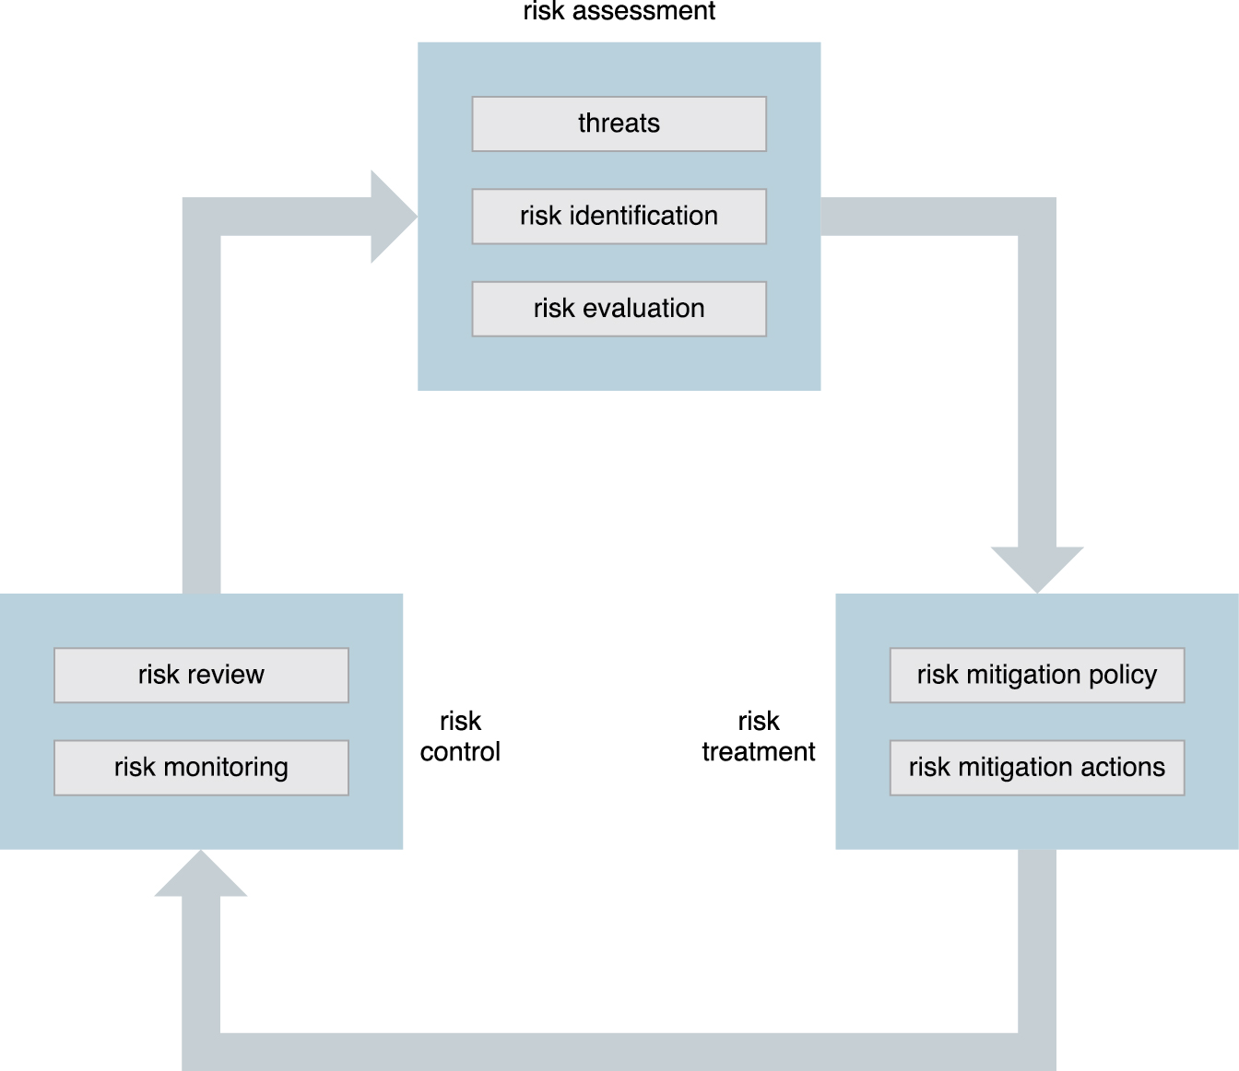
6.4. Additional Considerations
Figure 6.16 The on-going risk management process, which can be initiated from any of the three stages.
Notes:
Figure:

